Slide 1









Mutual benefits of joint species distribution models and laboratory data for the understanding of community dynamics #FruitFliesForEver…
CESAB - GDR TheoMoDiv
Benoit Facon, INRAE, UMR CBGP, Montpellier
Abir Hafsi, post-doc, UMR PVBMT, St-Pierre
Maud Charlery de la Masselière, Excelsus Plongée
Stéphane Robin, INRAE, Labo MMIP, Paris
François Massol, CNRS, UMR 9017 CIIL, Lille
Maxime Dubart, post-doc, UMR 8198 EEP Lille
Julien Chiquet , INRAE, Labo MMIP
Enric Frago, INRAE, UMR CBGP, Montpellier
Frédéric Chiroleu, CIRAD, UMR PVBMT, St-Pierre
Pierre-François Duyck, CIRAD, UMR PVBMT, Nouméa
Virginie Ravigné, CIRAD, UMR PHIM, Montpellier
Projet ANR Next Generation Biomonitoring - D. Bohan

Slide 2
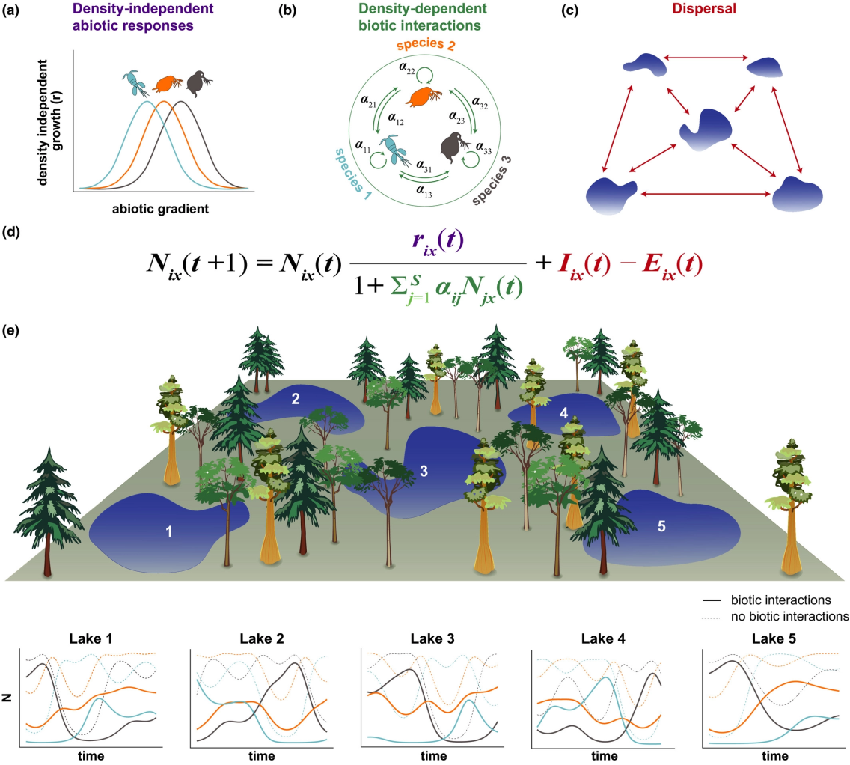
Community ecology
Regional species pool
Ecological drift under species loss and immigration processes
?
Niche
Species interactions
Observed communities
Thompson et al. 2020 Eco Lett

Slide 3
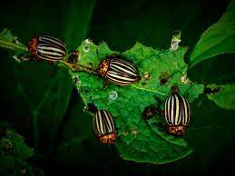
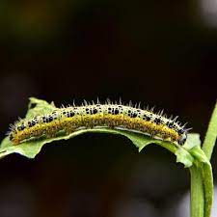
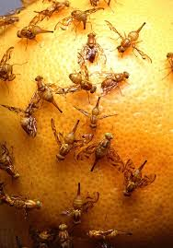
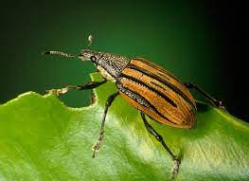
Phytophagous insects
… are among the most abundant and diversified group on the planet
… are often key species in the ecosystem due to their multiple effects on plants
Niche has at least two classes of dimensions
abiotic (e.g., climate, environment)
biotic = host plants
Does competition shape abundances?
Many laboratory competition experiments suggest YES (ex : Denno et al. 1995, Kaplan & Denno 2007)
BUT no pattern of negative coocurrence in natural communities (ex: Tack et al. 2009, Brazeau & Schamp 2019)

Slide 4
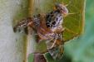
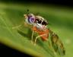
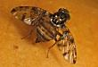
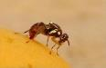
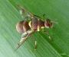
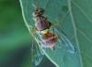
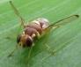
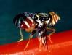
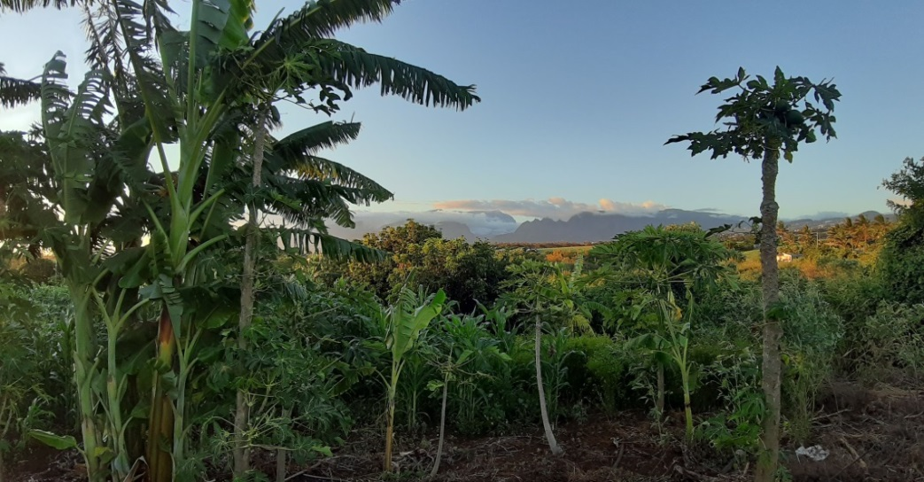
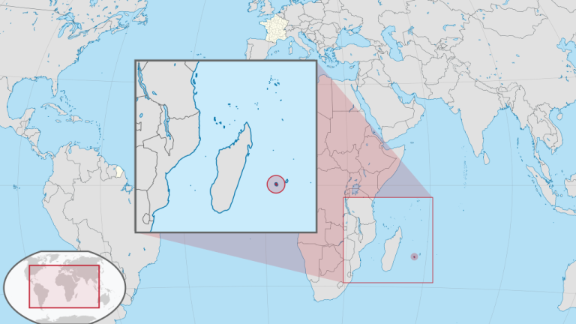
Fruit flies in Réunion
A community with 8 Tephritidae fruit flies in true sympatry in Réunion
C. catoirii
C. capitata
C. quilicii
B. zonata
D. demmerezi
Z. cucurbitae
D. ciliatus
N. cyanescens
© Virginie Ravigné
Photos : Antoine Franck

Slide 5
Fruit flies in Réunion
A community with 8 Tephritidae fruit flies in true sympatry in Réunion
Ceratitinae
Dacinae
C. catoirii
C. capitata
C. quilicii
B. zonata
D. demmerezi
Z. cucurbitae
D. ciliatus
N. cyanescens
© Virginie Ravigné
Photos : Antoine Franck

Slide 6
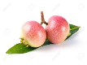

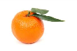
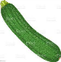



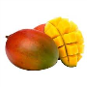


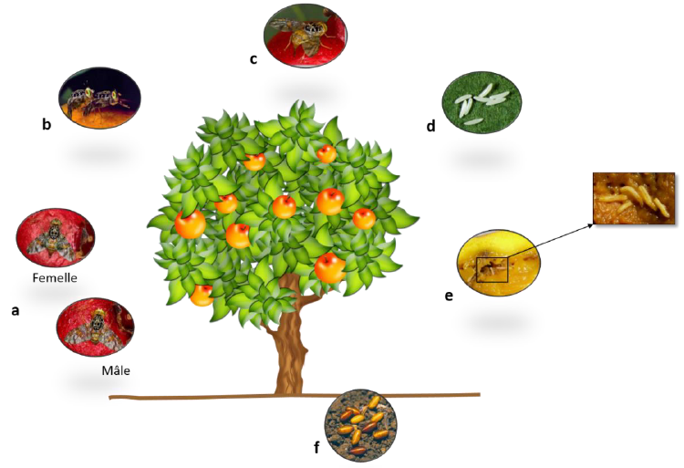

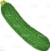
Fruit flies in Réunion
> 100 host plant species
Generalists
Specialists
C. catoirii
C. capitata
C. quilicii
B. zonata
D. demmerezi
Z. cucurbitae
D. ciliatus
N. cyanescens
Photos : Antoine Franck

Slide 7
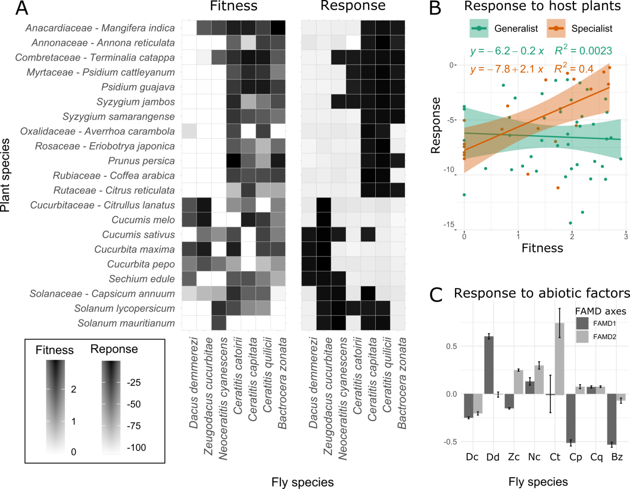
Generalists
C. catoirii
C. capitata
C. quilicii
B. zonata
Specialists
D. demmerezi
Z. cucurbitae
D. ciliatus
N. cyanescens
Laboratory measures of female preference and larval performance (hatching rate + development time + survival rate) on 21 plants hôtes (Abir Hafsi & Maud Charlery de la Masselière)
→ Fundamental host plant range
Photos : Antoine Franck

Slide 8
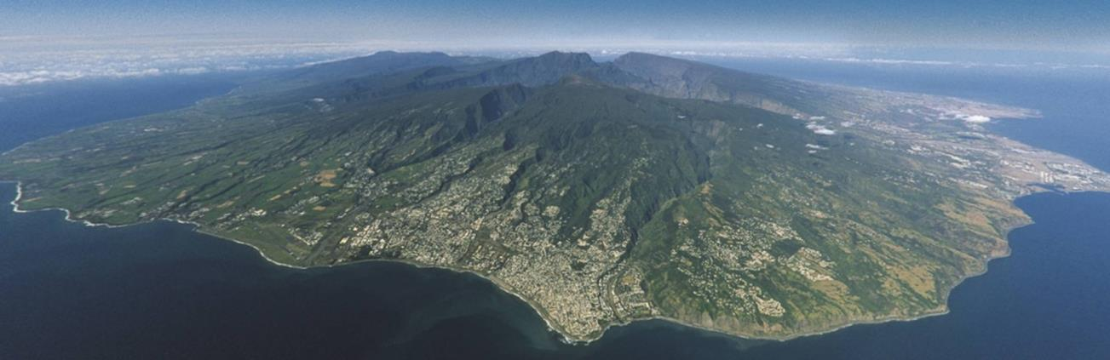
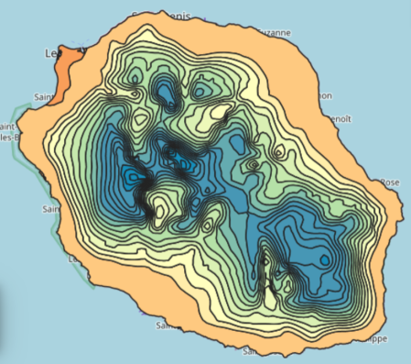
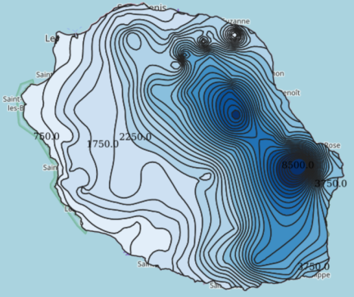
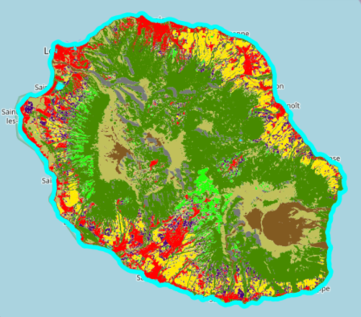
Ecological data
Elevation
Temperature
Rainfall
Land use
AWARE Cirad, Dupuy & Gaetano 2019

Slide 9
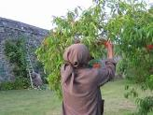
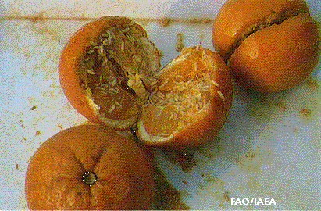
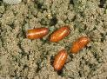

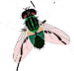
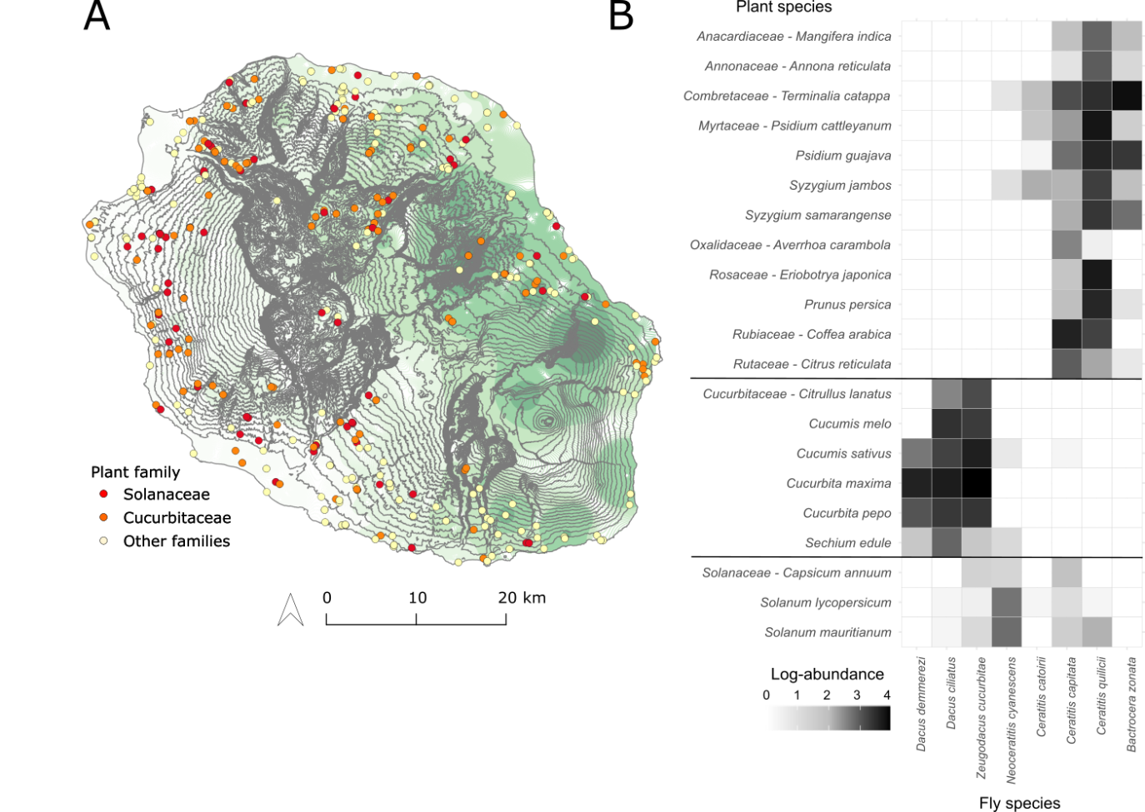
Abundances
12872 fruit samples
(> 40 host plant species)
GPS coordinates + Host species sampled at least 10 times + At least one fly alive + One of the 21 host plants studied in the lab
4918 observations of 8 fly species
soit > 95 000 individual flies
On 21 host plants
= 104 field sessions on 380 sites
between 1991 and 2009

Slide 10

Modelling joint species distributions with PLNmodels
! Phenomenological !
Abundance matrix
~
Poisson(exp(intercept + covariates + log(offset) + residual matrix))
Residual covariations not explained by confounding factors
« « « Significant » » » residual associations
Sparsification
Chiquet et al. 2018,2019

Slide 11
Get insights into the relative importance of niche factors vs species interactions for abundances
Are niche factors sufficient to explain abundances?
Compare PLN models
Eco-climatic factors
Full residual matrix
Host plants
Diagonal matrix
Does the residual matrix contains traces of potential interactions?
Have a look at the residual matrix of the best du meilleur model PLN (after sparsification)
Do fly species distribute as expected from their fundamental niche?
Compare realised vs. fundamental niches
Abundances → Regression coefficients = responses of abundances to host plants
Laboratory fitness measures

Slide 12
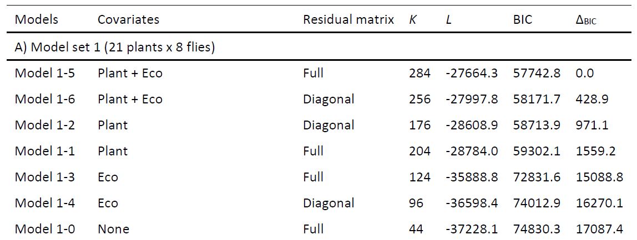
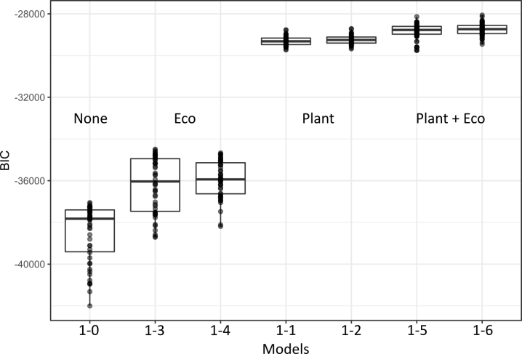
1. Are niche factors sufficient to explain abundances? Model selection
BIC distributions for 50 bootstraped datasets
The best model takes plant + eco
Full residual matrix is slightly better than diagonal matrix but this does not hold on bootstraped datasets (= non significant)

Slide 13
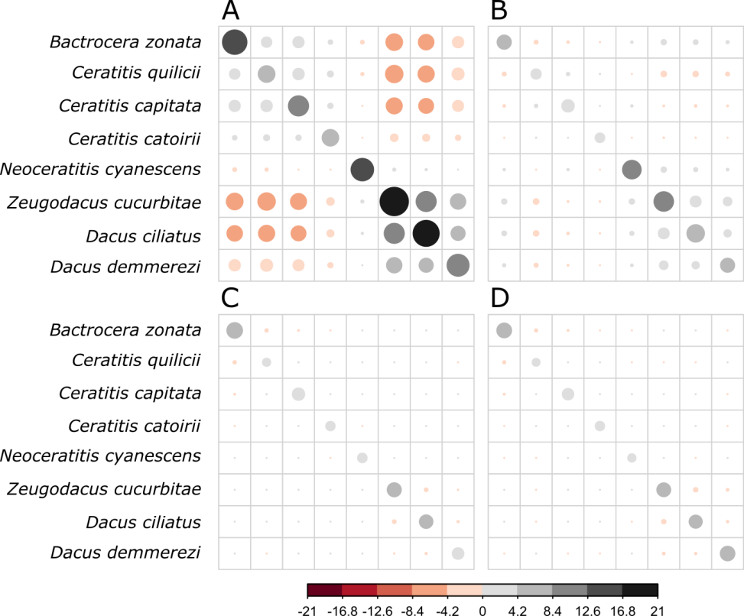
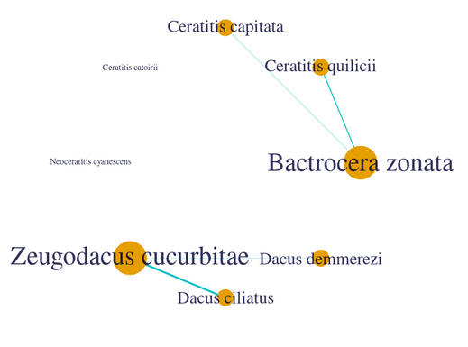
Does the residual matrix contains traces of potential interactions?
No covariate
ECO
Very small residual covariations once host plants are accounted for
Généralistes
Weak but significant negative residual covariations between specialists of Cucurbitaceae and between the most abundant generalists
Spécialistes des Cucurbitaceae
PLANT
ECO + PLANT
Covariances négatives
Covariances positives

Slide 14






3. Do fly species distribute as expected from their fundamental niche?
Mostly yes, but…
Looks like competitive exclusion of generalists by specialists on Cucurbitaceae

Slide 15
3. Les mouches se distribuent-elles conformément à leur niche fondamentale ?
« species sorting » vs. « mass effect » ??
Leibold et al. 2004

Slide 16
Get insights into the relative importance of niche factors vs species interactions for abundances
… still very complex!
From JSDM only:
The residual covariance matrix also contains associations stemming from omitted factors, local extinctions…
Competitive exclusion is a black hole for JSDM analysis
Leads:
Systematically confront with laboratory data/ integrate laboratory data as priors in the analysis
Invest on time series

Slide 17
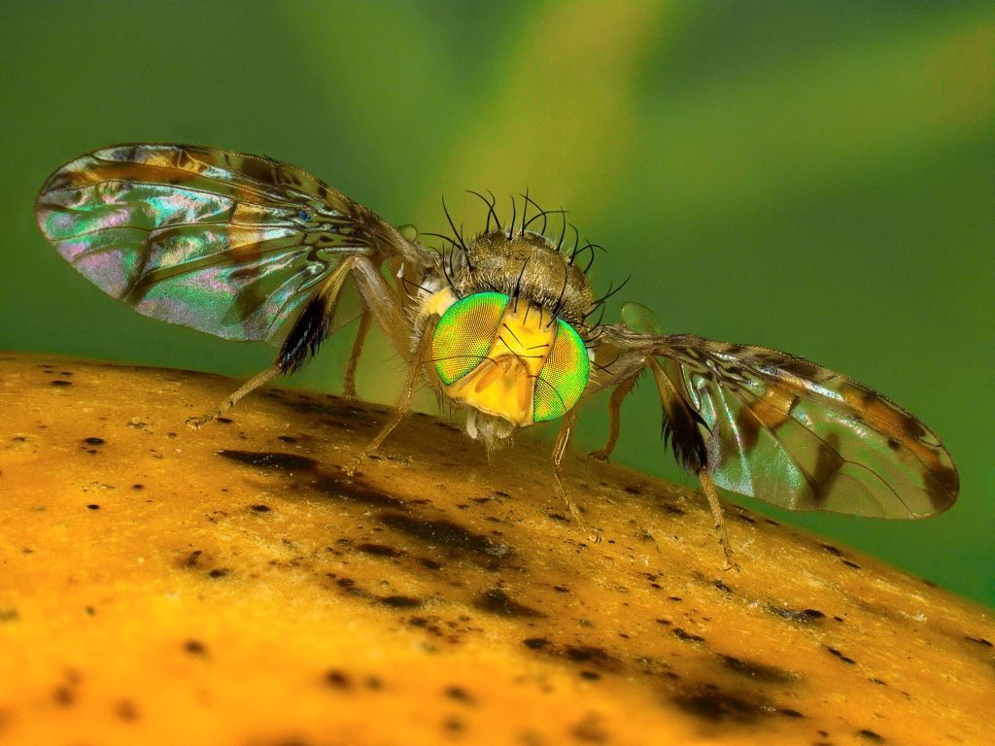
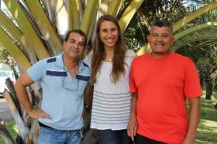



Thanks
©Antoine Franck
Jim Payet
Serge Glénac
Thomas Brequigny
Antoine Franck, Christophe Simiand, Patrick Turpin
Lionel Le Mézo
Michaël Mézino
Stéphane Dupuy
Projet ANR Next Generation Biomonitoring - D. Bohan
Dave Bohan, Corinne Vacher
Facon B., Hafsi A., Charlery de la Masselière M., Robin S., Massol F., Dubart M., Chiquet J., Frago E., Chiroleu F., Duyck P.-F., & V. Ravigné (2021) Joint species distributions reveal the combined effects of host plants, abiotic factors and species competition as drivers of community structure in fruit flies. bioRxiv, 2020.12.07.414326. ver. 4 peer-reviewed and recommended by Peer community in Ecology. Also published in Ecology Letters.

